Slide 1
Presenting Your Speech
Practice makes the difference

Slide 2
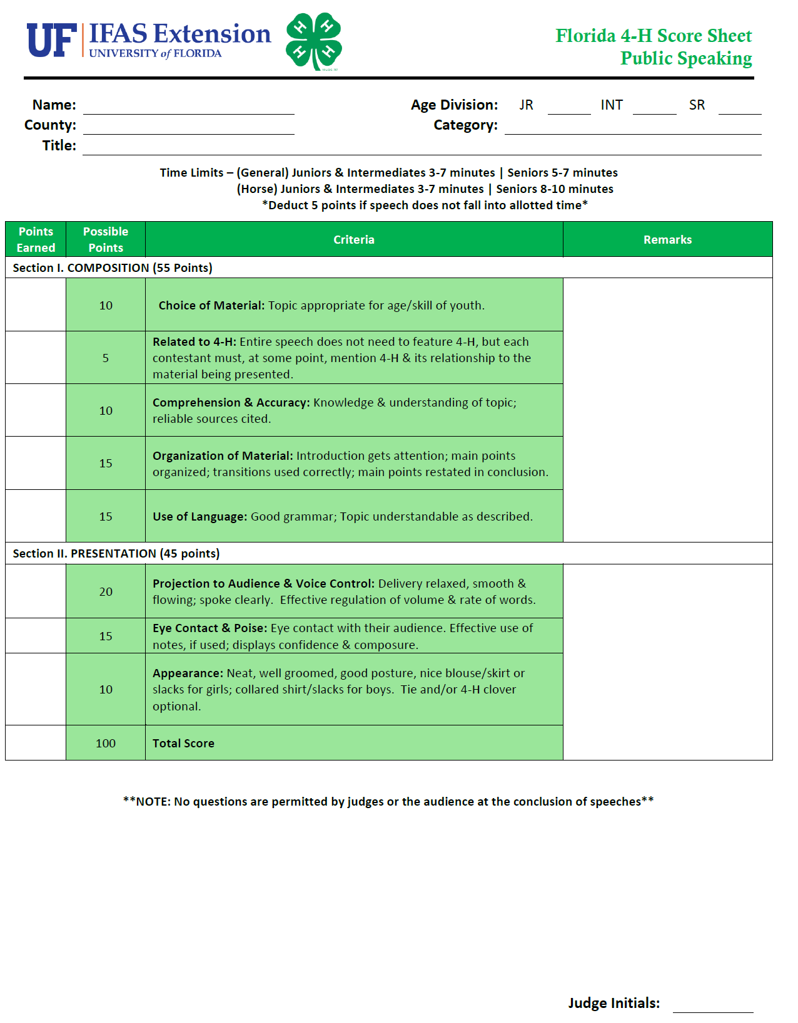

Slide 3
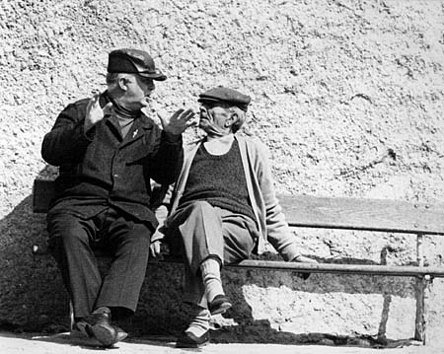
Projection to Audience & Voice Control
Breathe deeply
Vary your pitch
Enunciate your words
Speak at a conversational pace
Pauses are used for emphasis or giving the audience time to think about a statement
Speak loudly

Slide 4
Body Language
Whole body movement
Relaxed, balanced stance
Vary positions to provide transitions from one point to another
Move around stage as it fits your speech- DON’T PACE!!!!

Slide 5
Gestures
Move hands with a purpose
Conventional gestures
Two fingers for number 2
Raised hand for “stop”
Descriptive gestures
Hold hands apart to show distance
Draw wavy line for curved road
Emotional gestures
Clenched fist for anger or determination
Shrugging the shoulders to show indifference
Activity

Slide 6
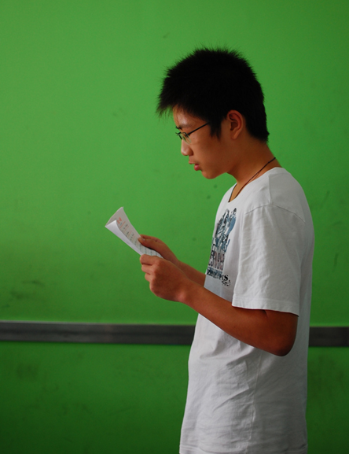
Eye Contact & Poise
Make eye contact with all areas of the audience, especially the judges
SMILE
Don’t read
Note cards with highlights

Slide 7
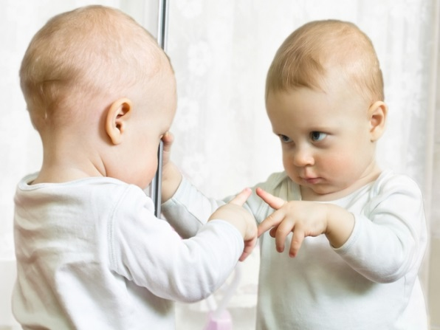
Practice, Practice, Practice
Practice ideas, don’t memorize words
Speak like you are having a conversation
Every time you start a speech, finish it
Practice in front of a mirror
Practice in front of family or friends
Check time
Notes:
Practice ideas, don’t memorize words
Speak like you are having a conversation not giving a lecture
Every time you start a speech, finish it
Practice in front of a mirror until you like what you hear and see
Practice in front of family or friends that will give you helpful feedback
Check time

Slide 8
Putting It All Together
I Will Be There

